Slide 1
Using Morphogenetic Models to Develop Spatial Structures
Jacob Beal, Jessica Lowell, Annan Mozeika, Kyle Usbeck
October 3, 2011
Spatial Computing workshop at IEEE SASO 2011
Work sponsored by DARPA; the views and conclusions contained in this document are those of the authors and not DARPA or the U.S. Government.
Notes:
Hello.
Name.
BBN Technologies.
Talking about some work done under the MADV (Morphogenetically Assisted Design Variation) DARPA project in cooperation with iRobot.

Slide 2
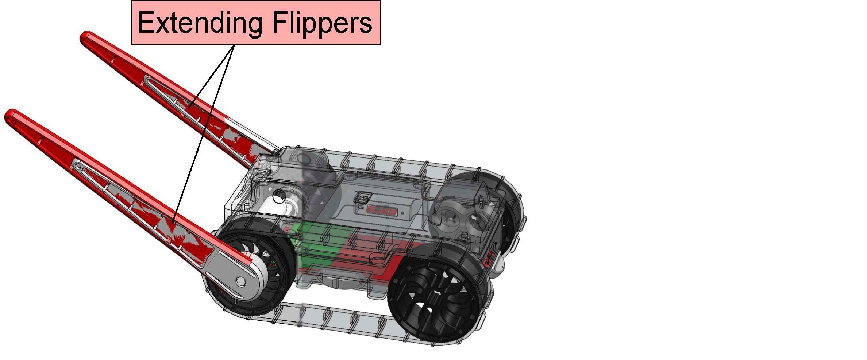
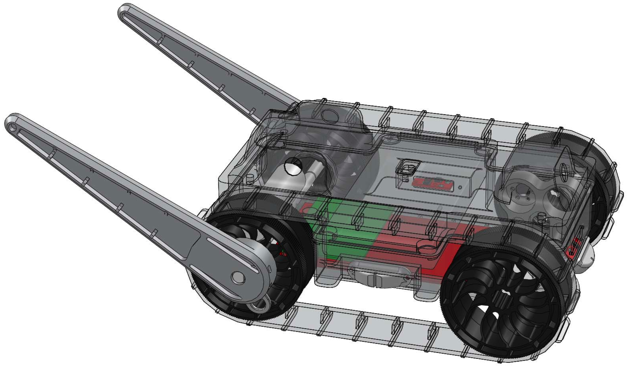
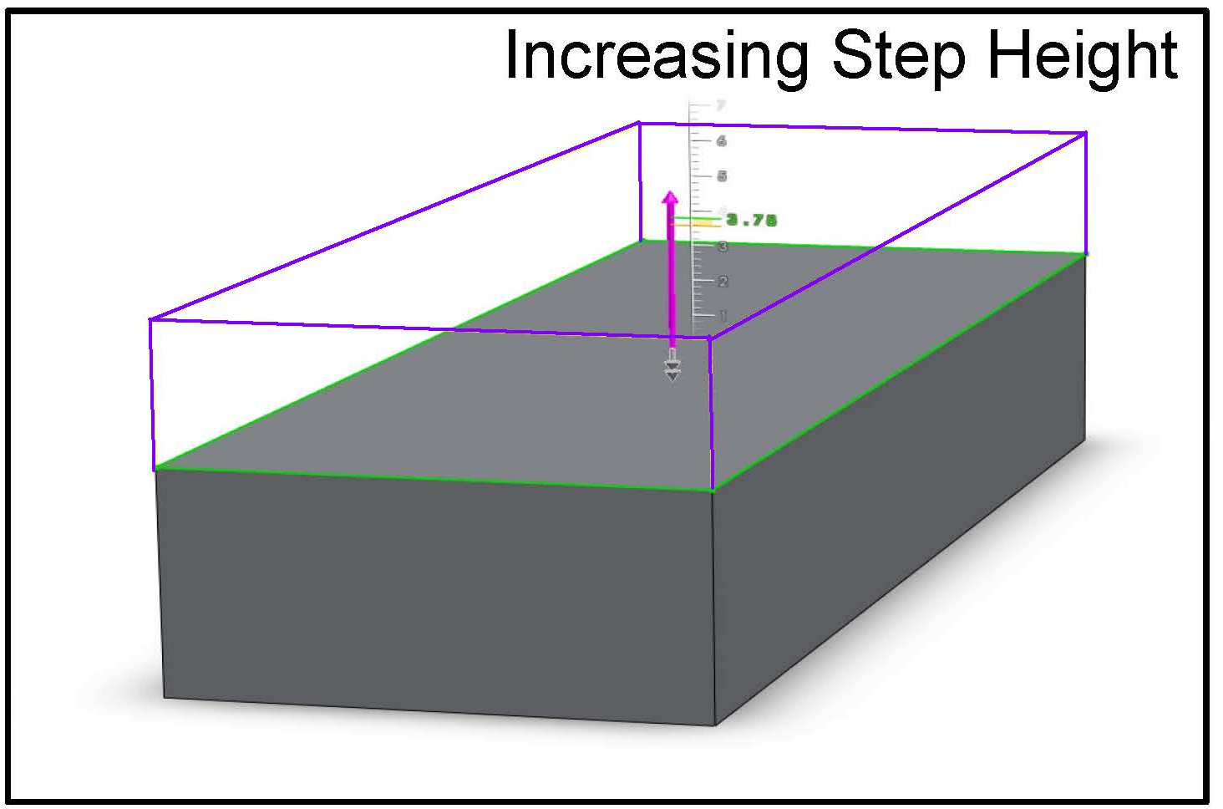
Problem: Form Adaptation
What needs to change for new conditions?
How does a change impact other systems?
Notes:
Consider the following problem:
Our miniDroid robot can climb a step (using flippers).
Step height increases.
Now the robot can’t climb it.
Intuitively, we can increase the size of the flippers to help the robot, but…

Slide 3
Problem: Form Adaptation
A small change ...

Slide 4
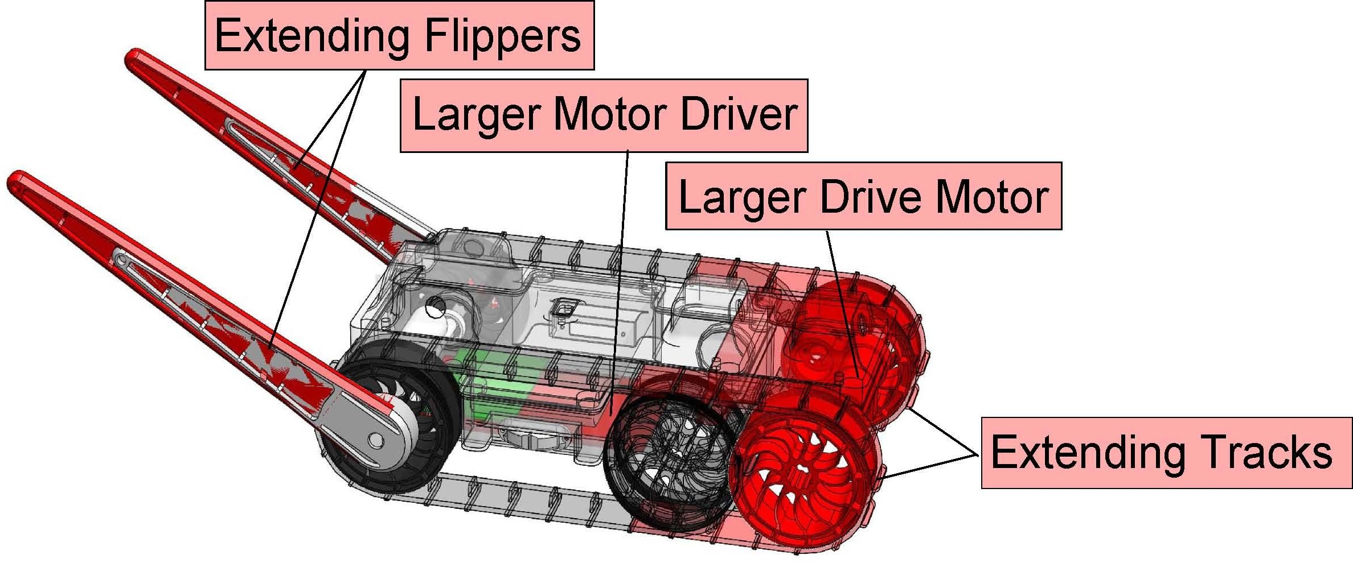
Problem: Form Adaptation
A small change ... has many consequences

Slide 5
Problem: Form Adaptation
A small change ... has many consequences
Problems: What to change? How to change it?

Slide 6
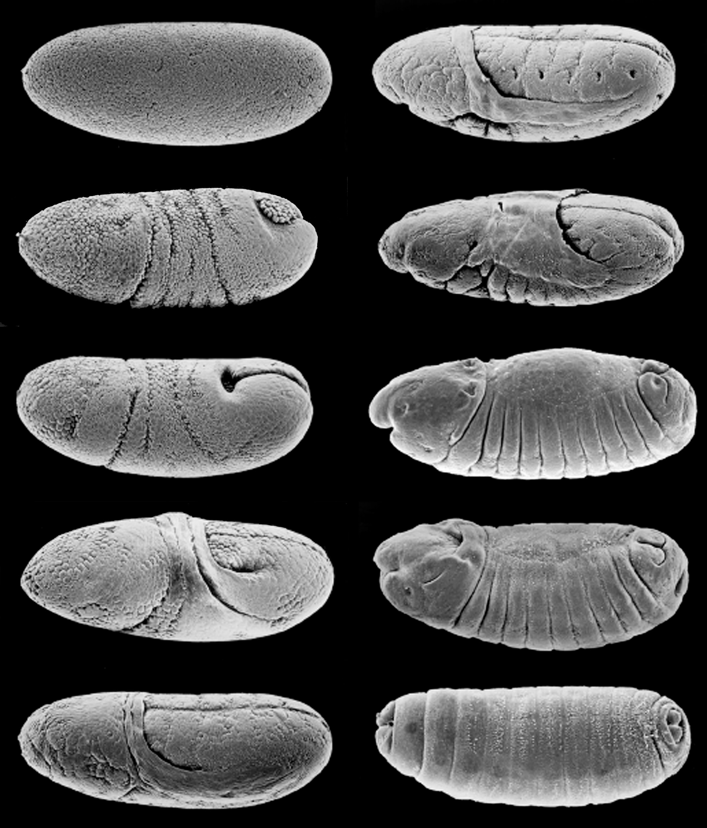
Approach: Morphogenesis
Process by which an object’s shape develops
Developmental Program
Bio-inspired design
No biomimicry for the
sake of biomimicry!
Drosophila Embryo Morphogenesis
Photo Credit: Parkhurst Labs
Notes:
Morphogenesis: Greek “morphe” (shape) and “genesis” (creation) means “beginning of the shape” – it’s the process that causes an object to develop its shape.
This process is specified in the developmental program.
You’ll see that our design is inspired by biology, but we have a rule in our lab…
We only mimic the aspects of biology that give us a clear benefit.

Slide 7
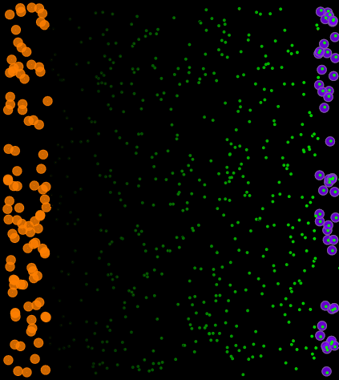
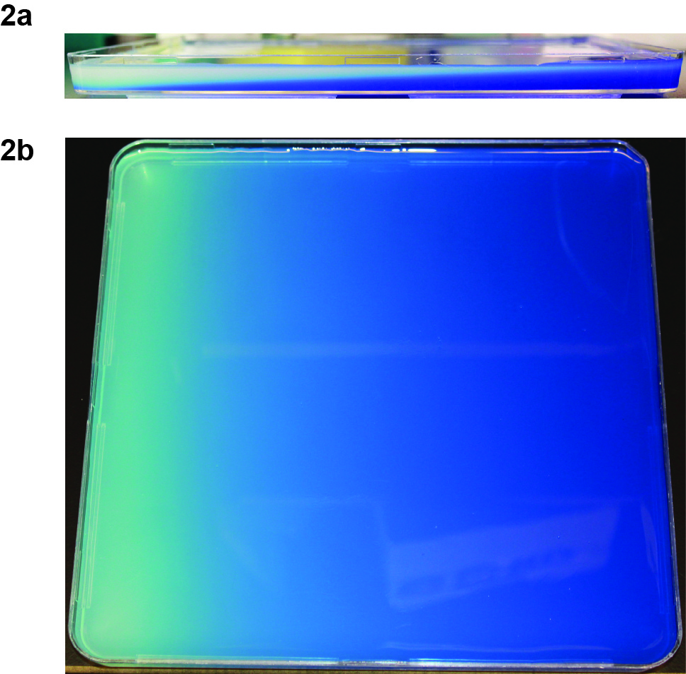
Spatial Computing
Morphogenesis as a method of developing spatial structures
Cellular-level execution of developmental programs
Photo credit: Center for Brain Science,
Harvard Uni.
Notes:
The problem relates to spatial computing because we’re looking at…

Slide 8
Outline
Goals for Developmental Programs
Developmental epochs
Structure of Developmental Programs
Developmental primitives
Developmental rules
Benefits of Developmental Programs
Reduce parameter dimensionality
Adaptable
Implicitly create a reference architecture for the engineered system
Contributions and Future Work

Slide 9
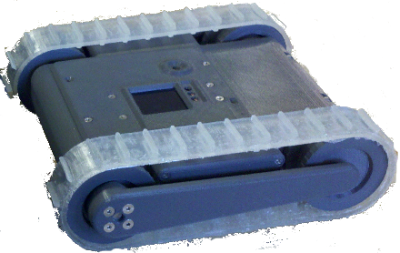
A Complex Transformation…
Both flippers are driven by one servo…

Slide 10
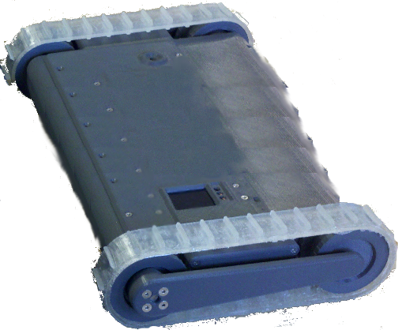
A Complex Transformation…
Both flippers are driven by one servo…
… what if the robot widens to need two?
How can we support this radical change?

Slide 11
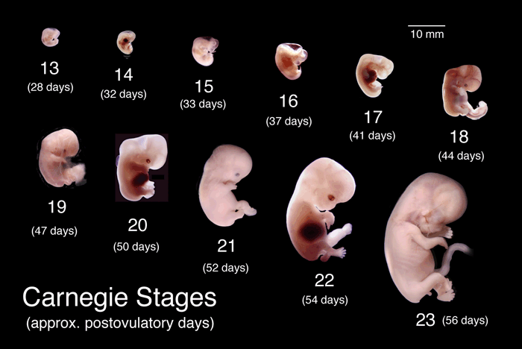
Developmental Epochs
Photo credit:
U. Michigan
Notes:
Organisms undergo stages of development
Engineering systems are likely to do the same
Preliminary ideas for developmental epochs:
Epoch 1 – body plan laid out, identify major components and their coordinate systems
Epoch 2 – scale to reach desired size and refine to full detail
Epoch 3 – variation in “real” environment
But how does adaptation work?

Slide 12
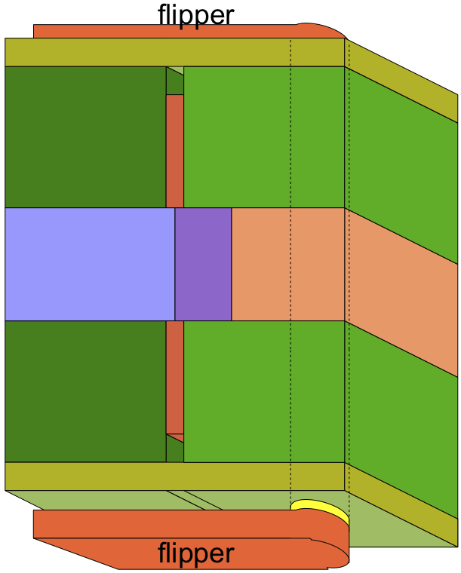
Goals for Developmental Programs
Layout primary body plan components
Establish relationships between components
Easy to modify

Slide 13
Outline
Goals for Developmental Programs
Developmental epochs
Structure of Developmental Programs
Developmental primitives
Developmental rules
Benefits of Developmental Programs
Reduce parameter dimensionality
Adaptable
Implicitly create a reference architecture for the engineered system
Contributions and Future Work

Slide 14
Structure of Developmental Programs
Set of developmental rules specifying preconditions and effects
Effects are compositions of developmental primitives
Why developmental rules?
Parallel application,
Implicit relations,
Easy to modify/insert
How rules work
Continuous manifold evolution,
Conflict resolution by actuator blending

Slide 15
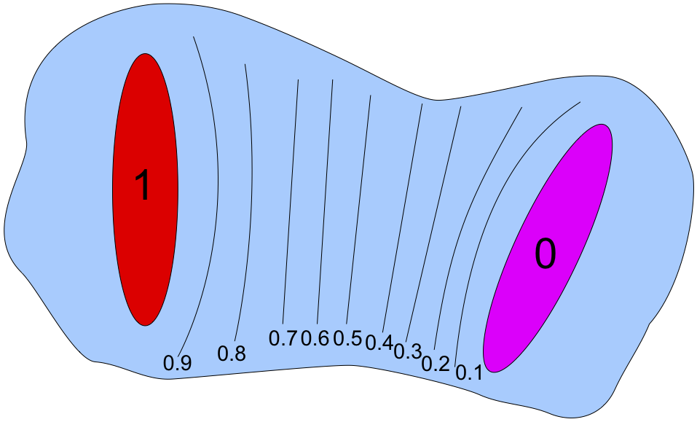
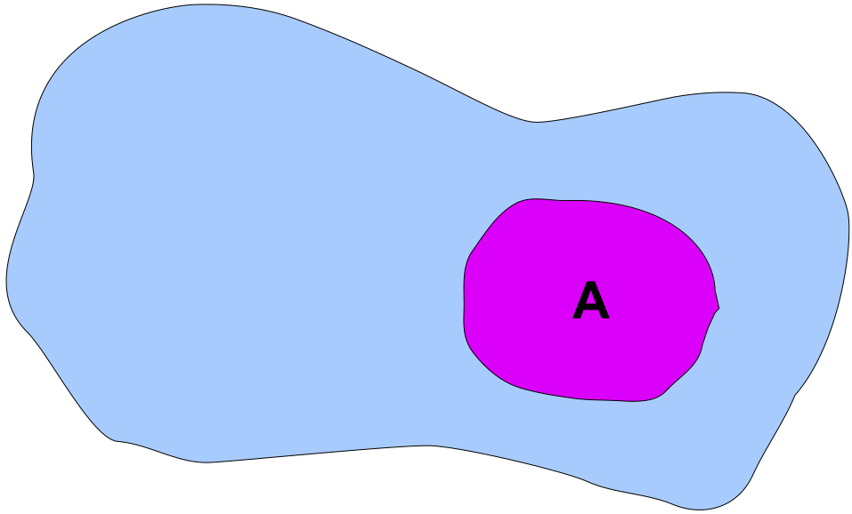
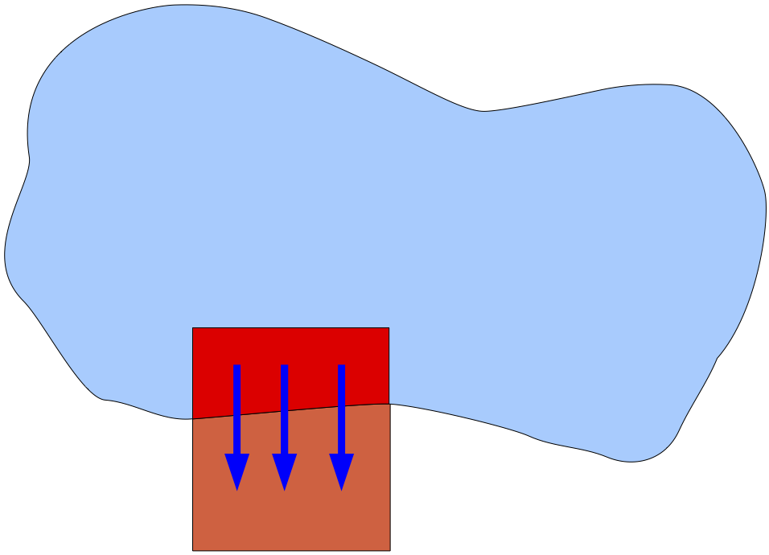
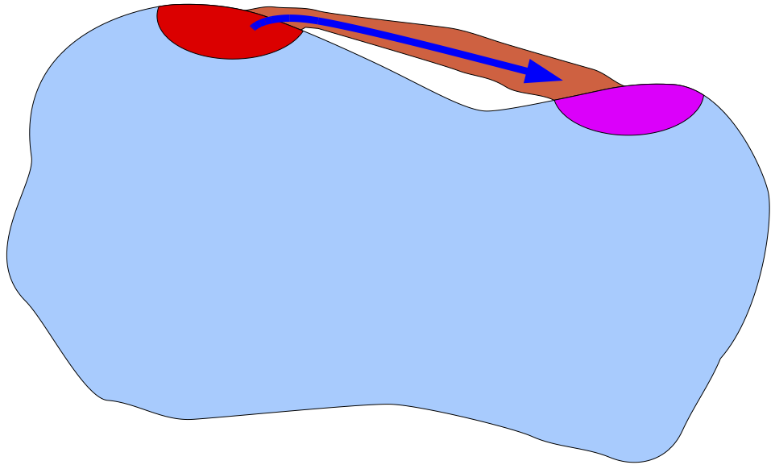
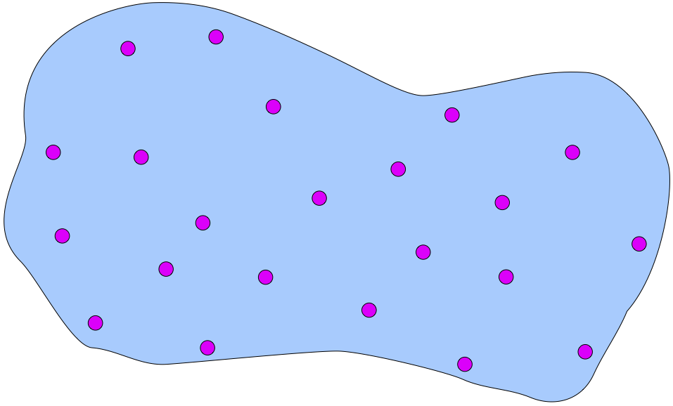
Developmental Primitives
We begin with 5 biology-inspired manifold operations:
Coordinatize
Latch
Scale
Connect
Speckle
Notes:
We believe these to be a basis set of operators for developing any structure.
Coordinatize – diffusion of a chemical gradient over a manifold
Latch – differentiation of a sub-manifold to a type
Scale – directed growth / proliferation
Connect – creates a path, like vascularization / cell migration
Speckle – randomly selects small regions. Inspired by symmetry-breaking (e.g., hair)

Slide 16
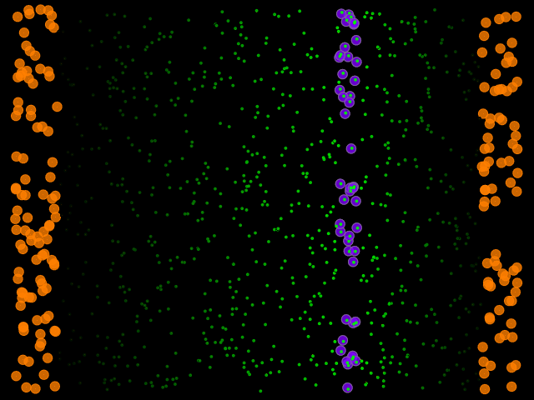
Coordinatize Primitive
coordinatize ( 0-region, 1-region )
Notes:
Computes a local coordinate system between two regions, ranging from 0 in one region linearly to 1 in the other region. It is based on the use of chemical gradients to polarize tissues, and most particularly on those where the signal is the ratio of two chemicals.

Slide 17
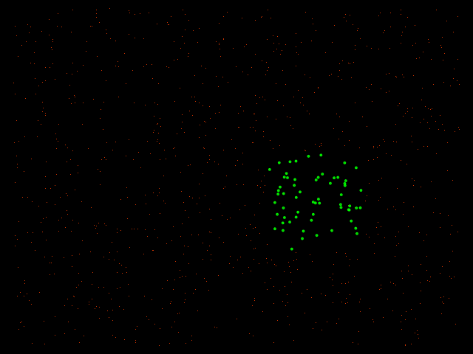
Latch Primitive
latch ( region, type )
Notes:
Differentiates a region into a type. Analogous to determination of cell fate such as the determination of limb fields.

Slide 18
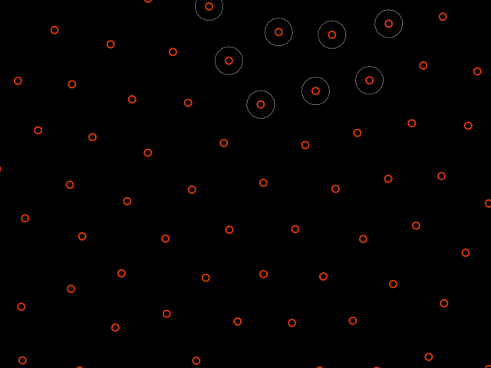
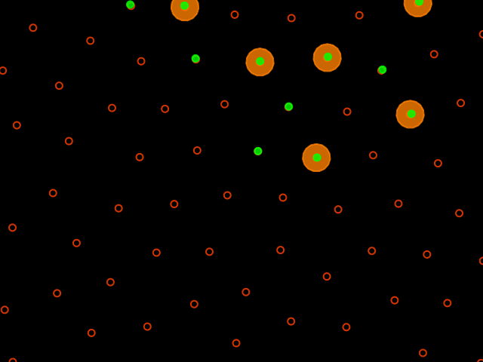
Scale Primitive
scale ( region, scale-factor )
Notes:
Takes a region and increases or decreases its scale proportionately along one or more axes. This is inspired by directed proliferation, such as is used in the construction of limb buds.

Slide 19
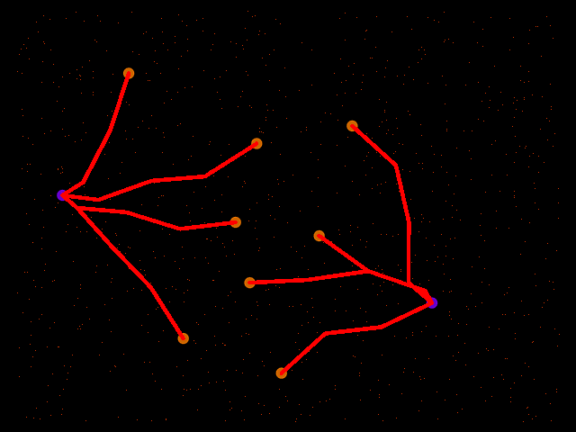
Connect Primitive
connect ( source-region, destination-region )
Notes:
A region extends from a source region along a near-shortest path to a destination region. This operation is based on cell migration, particularly the migration of tissue sheets, and on the extension of cell processes such as axons. We have tentatively specified that only the closest point in the source will connect, and that the width of the connection will be proportional to the size of the smaller region.

Slide 20
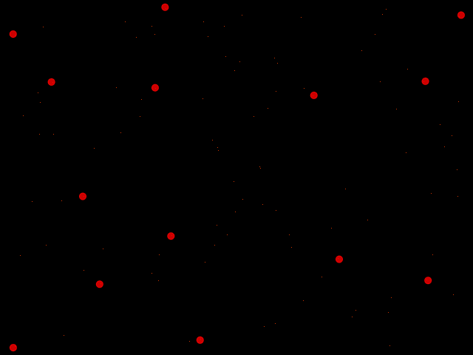
Speckle Primitive
speckle ( region, expected-separation )
Notes:
Selects a set of small regions filling the space, each region determined randomly and separated by an expected distance from all others nearby. This is inspired by symmetry-breaking operations, such as those used to create hair follicles.

Slide 21
Developmental Rules
Precondition: Tissue = limb-bud
Proximodistal exists
Effects: Scale(Proximodistal,1.5)
→ Latch(limb)
Precondition: Tissue = egg
Anteroposterior > 0.5
Mediolateral > 0.33
Effects: Latch(limb-bud)
Precondition: Tissue = limb
Proximodistal > 0.8
Effects: Latch(wheel)
Precondition: Tissue = egg
Anteroposterior < 0.5
Mediolateral > 0.33
Effects: Latch(limb-bud)
Precondition: Tissue = limb
Proximodistal < 0.8
Anteroposterior < 0.5
Effects: Latch(drive)
Precondition: Tissue = limb-bud
Effects: Coordinatize(Proximodistal)
Precondition: Tissue = limb
Proximodistal < 0.8
Anteroposterior > 0.5
Effects: Latch(mount)
Notes:
Those primitives are effects developmental rules, such as these, to create a developmental program.
Note how the rules use pre-conditions to retain loose-coupling…

Slide 22
Developmental Rules
Precondition: Tissue = limb-bud
Proximodistal exists
Effects: Scale(Proximodistal,1.5)
→ Latch(limb)
Precondition: Tissue = egg
Anteroposterior > 0.5
Mediolateral > 0.33
Effects: Latch(limb-bud)
Precondition: Tissue = limb
Proximodistal > 0.8
Effects: Latch(wheel)
Precondition: Tissue = egg
Anteroposterior < 0.5
Mediolateral > 0.33
Effects: Latch(limb-bud)
Precondition: Tissue = limb
Proximodistal < 0.8
Anteroposterior < 0.5
Effects: Latch(drive)
Precondition: Tissue = limb-bud
Effects: Coordinatize(Proximodistal)
Precondition: Tissue = limb
Proximodistal < 0.8
Anteroposterior > 0.5
Effects: Latch(mount)
Notes:
…which allows for parallel execution and simple addition/modification/removal of rules.

Slide 23
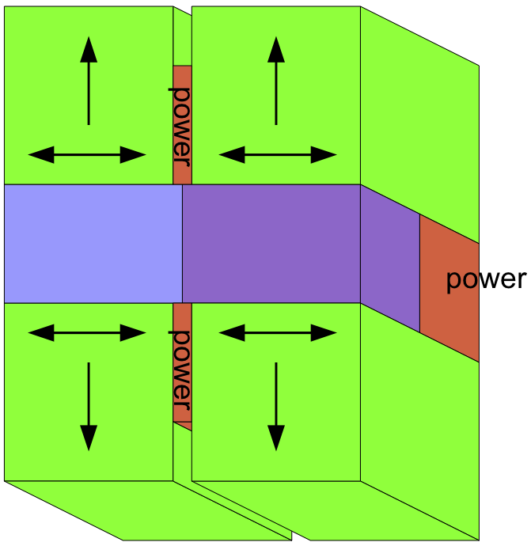
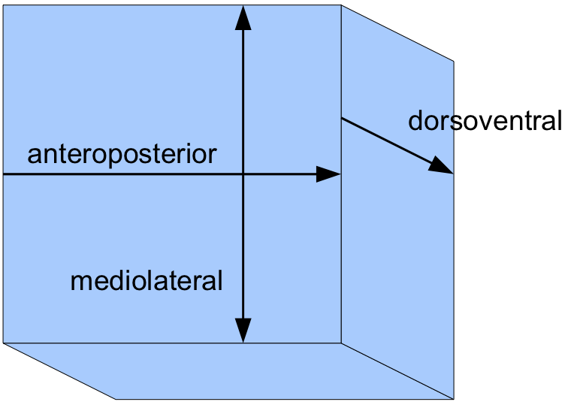
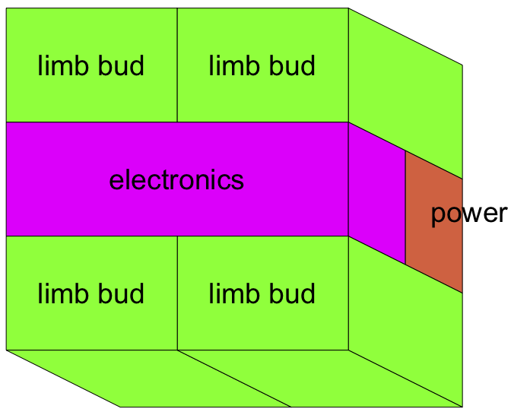
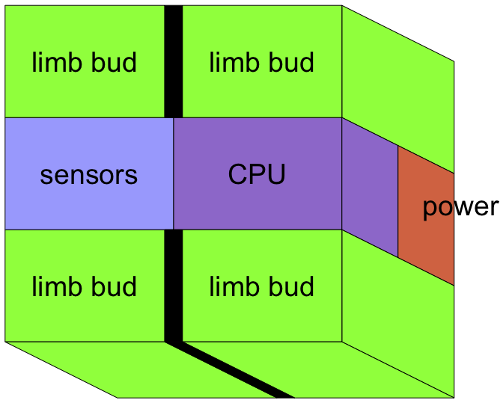
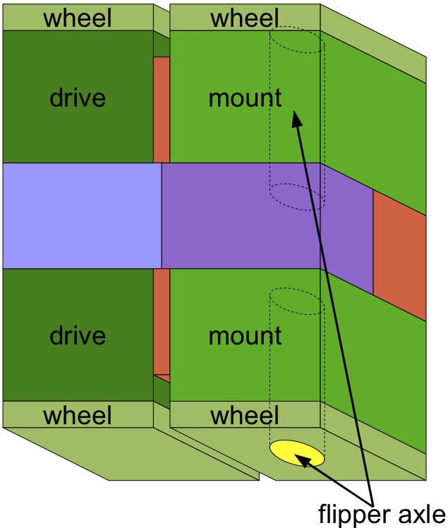
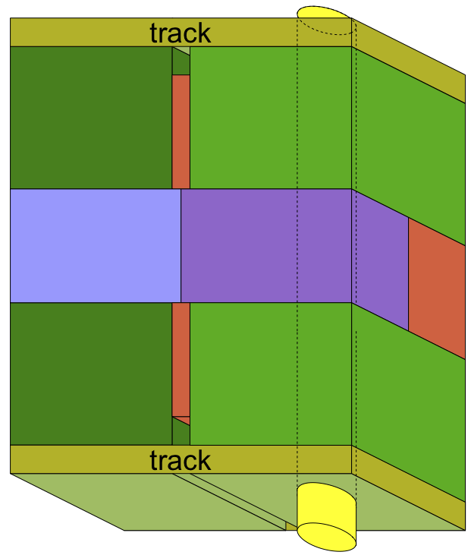
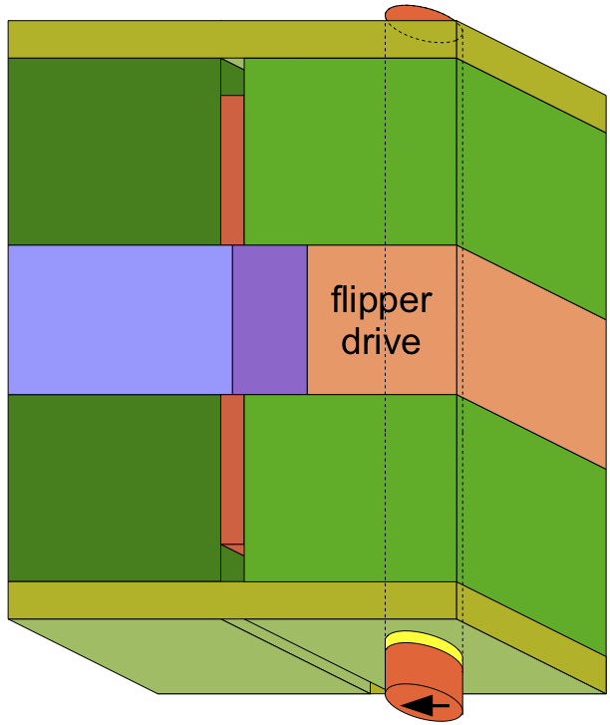
Developmental Program for Body Plan
Next: prenatal growth
Notes:
1 – establish axes: anteroposterior (head to tail), dorsoventral (front to back), and mediolateral (middle to sides – bilaterally symmetric) coord
2 – establish rough components: latch limb buds, power, and electronics latch
3 – electronics → sensor & CPU coord, latch
4 – limb buds scale
5 – limb buds → wheel, drive, mount latch
6 – flipper axels scale, connect
7 – flipper axels scale out and latch as flipper bud/drive scale, latch
8 – flipper scales from bud scale

Slide 24
Outline
Goals for Developmental Programs
Developmental epochs
Structure of Developmental Programs
Developmental primitives
Developmental rules
Benefits of Developmental Programs
Reduce parameter dimensionality
Adaptable
Implicitly create a reference architecture for the engineered system
Contributions and Future Work

Slide 25
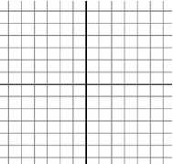
Benefits of Developmental Programs
Reduce parameter dimensionality
Adaptable
Implicitly create a reference architecture for the engineered system
Notes:
Simple box has at least 9 parameters: position, orientation (pitch, yaw, roll), side lengths (height, length, depth)

Slide 26
How Hard is it to Change Flipper Length?

Slide 27
How Hard is it to Change Flipper Length?
Does it grow from the center?

Slide 28
How Hard is it to Change Flipper Length?
Does it grow from the center? the front?

Slide 29
How Hard is it to Change Flipper Length?
Does it grow from the center? the front? the back?

Slide 30
How Hard is it to Change Flipper Length?
Only a few parameters are key, while most are constrained by their relationships to key parameters.
Developmental programs encode the spatial relationships between components, effectively reducing the number of design parameters.

Slide 31
Benefits of Developmental Programs
Reduce parameter dimensionality
Adaptable
Implicitly create a reference architecture for the engineered system

Slide 32
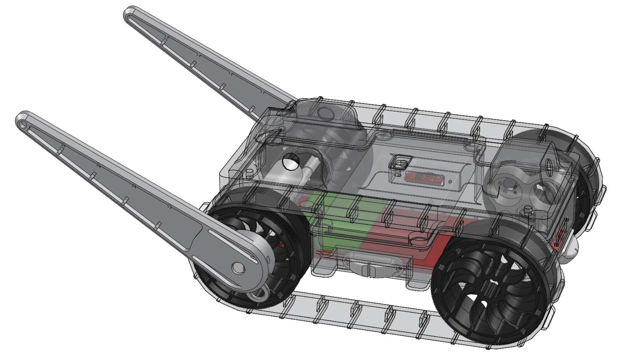
Embryonic Adaptation
…
…
…
…
Post-natal
Post-natal
Post-natal
Post-natal
Pre-natal
Pre-natal
Pre-natal
Pre-natal
Body Plan
Body Plan
Body Plan
Body Plan
Egg
Egg
Egg
Egg
Notes:
Mature Adaptation – more incremental and less disruptive to a running system
Embryonic Adaptation – offers potential for more radical change – just one example of why they ne
Developmental programs need to be adaptable so that they can continue to run on modified eggs – if we stretch the egg.

Slide 33
Benefits of Developmental Programs
Reduce parameter dimensionality
Adaptable
Implicitly create a reference architecture for the engineered system
A reference architecture captures the “best practices” for an architectural solution in a particular domain.
Notes:
Reference architecture is a document that specifies the architectural best practices in some domain.
They’re often derived from reference models, or lessons learned from designing implementations of some system.
But you might be asking, “how does a developmental program capture best practices?”

Slide 34
Writing Developmental Programs
Egg
…
…
Notes:
Consider the process of writing a developmental program…
In doing so, you have to make a number of design decisions that affect the components of the system spatially.
But what happens when someone goes to change your design? How do you explain your design rationale?

Slide 35
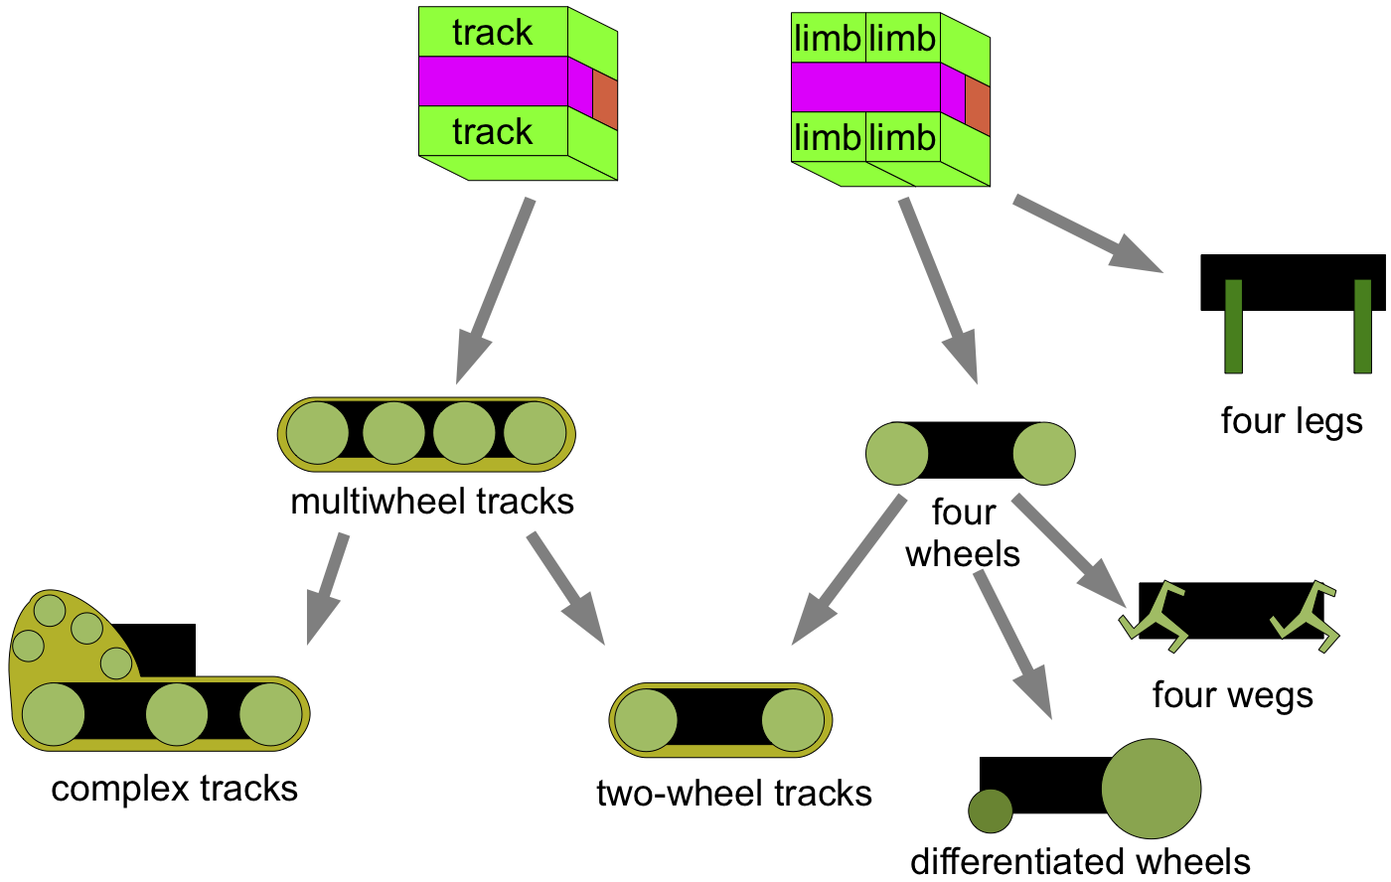
Creating a Reference Architecture
The sequence of development for a body plan implies a prioritization of major design features, selecting a family of more accessible variants
Notes:
Developmental programs capture design decisions in a type of Reference Architecture!
These are not the only possible types, just some examples.

Slide 36
Creating a Reference Architecture
The sequence of development for a body plan implies a prioritization of major design features, selecting a family of more accessible variants
Notes:
Reference Architecture! These are not the only possible types, just some examples.

Slide 37
Creating a Reference Architecture
The sequence of development for a body plan implies a prioritization of major design features, selecting a family of more accessible variants
Notes:
Reference Architecture! These are not the only possible types, just some examples.

Slide 38
Creating a Reference Architecture
The sequence of development for a body plan implies a prioritization of major design features, selecting a family of more accessible variants
Notes:
Reference Architecture! These are not the only possible types, just some examples.

Slide 39
Contributions & Next Steps
Proposed morphogenesis as a method of developing spatial structures
Explained how developmental programs encode relationships between design decisions
Described our preliminary morphogenetic engineering framework
Next: A full implementation of tissue-level execution of developmental programs
Goal: Cellular execution of developmental programs

Slide 40
Project Team:
Jacob Beal (PI)
Aaron Adler (co-PI)
Susan Katz (PM)
Brett Benyo
Jeff Cleveland
Jessica Lowell
Hala Mostafa
Kyle Usbeck
Fusun Yaman
Interns:
Katie McGuire
Taylor Campbell
Annan Mozeika
Intern:
Gretchen Markiewicz
Team website:
http://madv.bbn.com
Sponsored by:

Slide 41
Backup

Slide 42
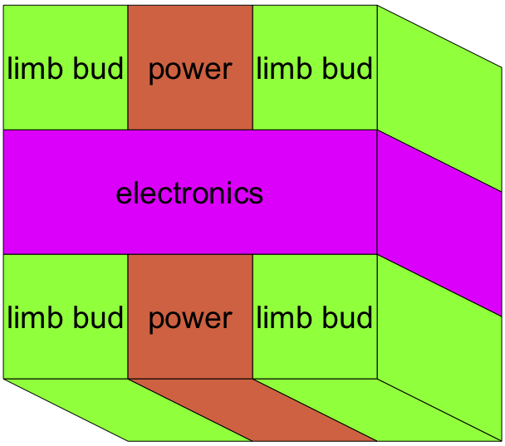
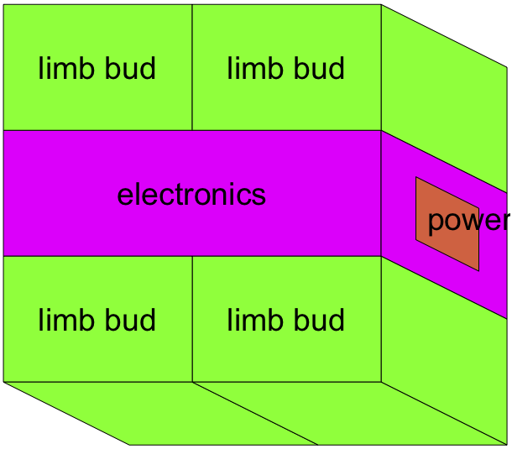
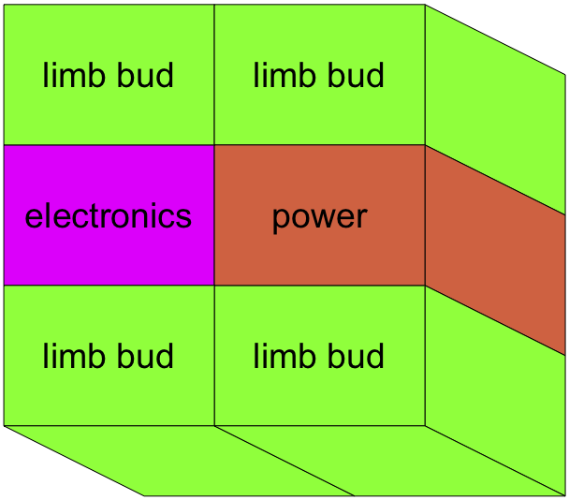
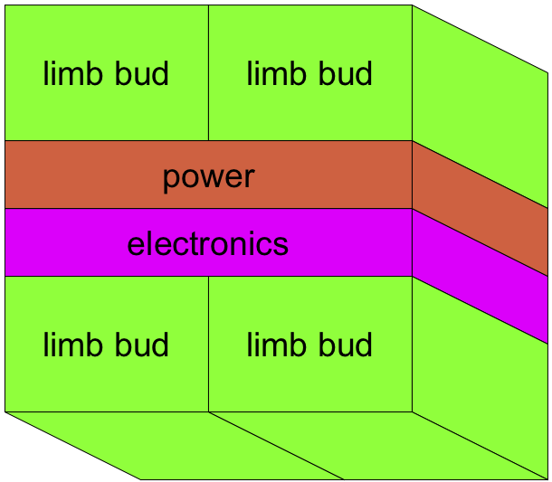
Considering Alternative Body Plans
Don’t split electrical or power components
Nested body adds complexity
Component weight differences affect stability

Slide 43
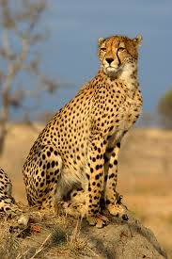
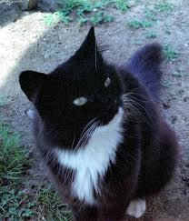
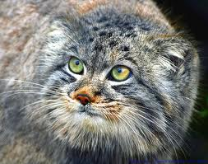
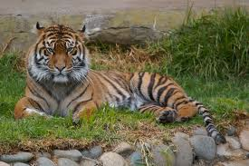
Morphogenesis enables natural variation
Felinae
Cheetah
Domestic Cat
Felis
Felidae
Pallas Cat
Puma
Pantherinae
Panthera
Tiger
Snow Leopard
Lion

Slide 44
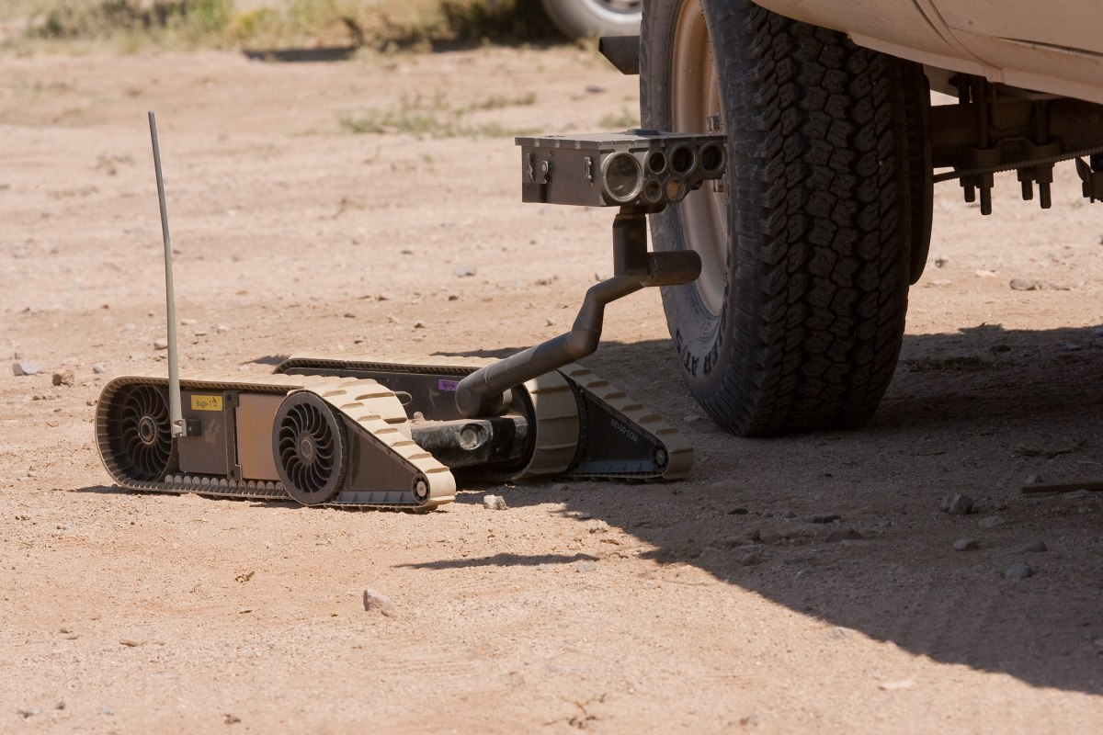
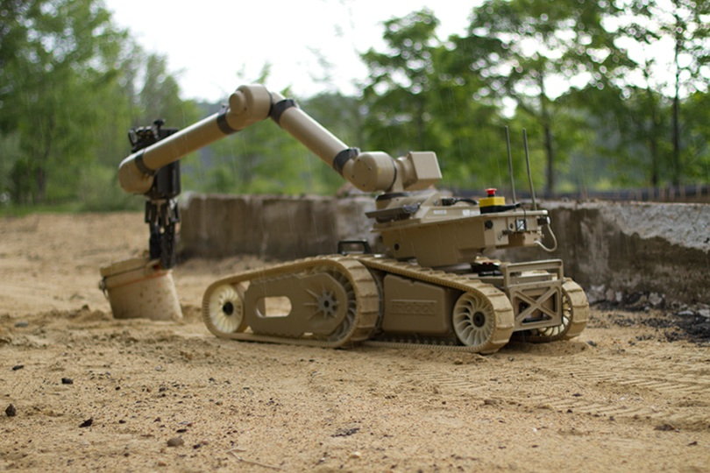
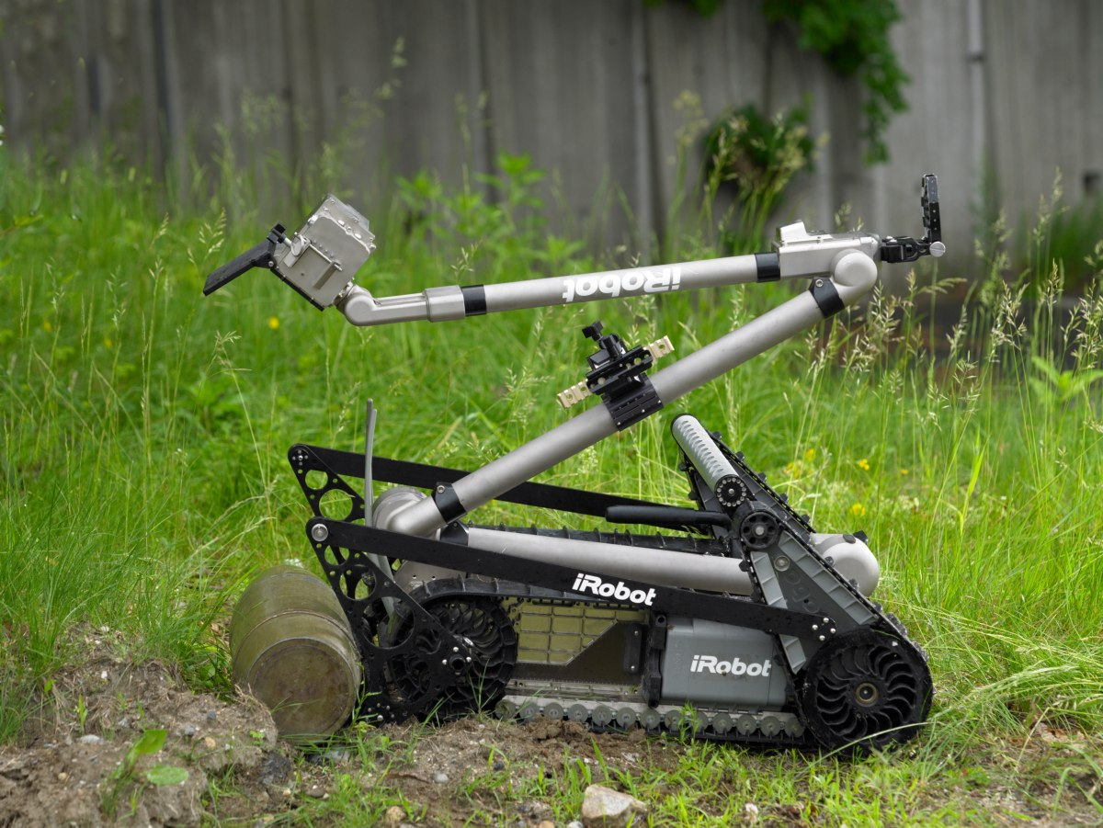
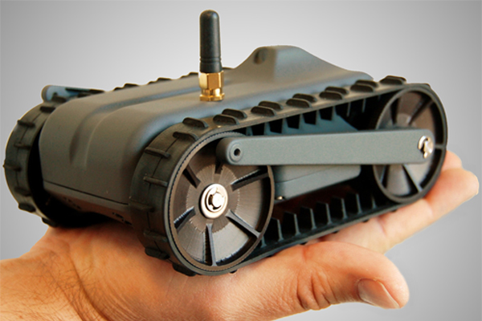
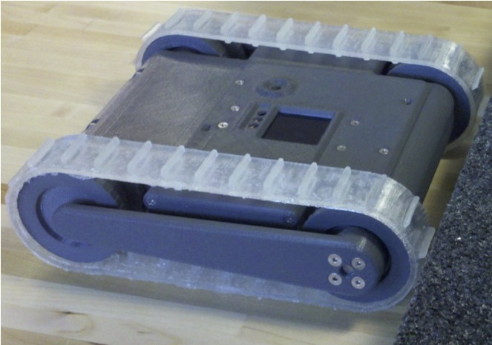
A taxonomy of engineered systems?
SUGV
Warrior
PackBot
LANdroid
miniDroid

Slide 45
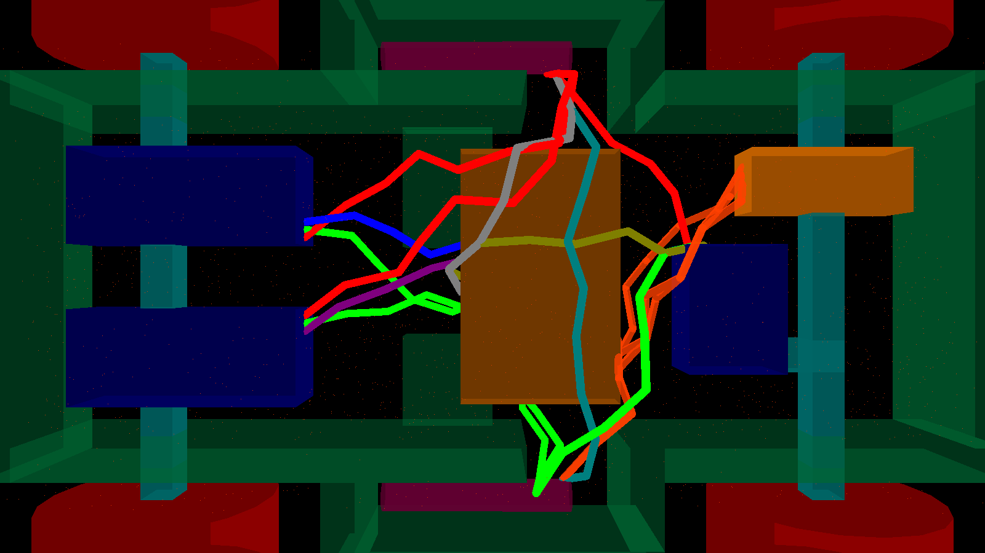
Details: Wiring
Chemotactic model:
battery
servo
encoder
CPU
servo
servo
battery

Slide 46
Other Key Developmental Decisions
Wheel attachments: packaged component with a “base limb” included within wheel
Flippers: based on wheel axles ensures flipper/wheel structure integrity, but makes them hard to separate

Slide 47
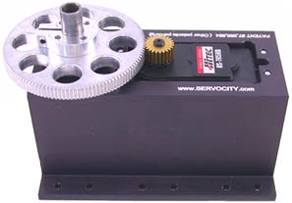
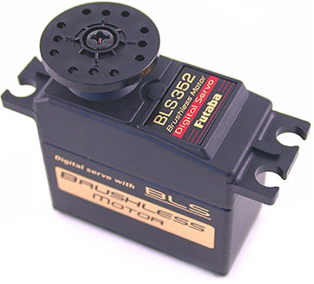
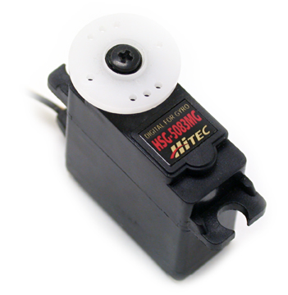
Details: Packaged Components
Approach: interpolate across parts from a “Component Model Library”

Slide 48
Cellular Scale Operator
The cells in the tissue seek uniform density.
We select the cells we want to scale.
The selected cells latch and turn green.
The green cells duplicate themselves (producing more green-type cells).
The cells continue seeking uniform density.
proto -m -l -L simple-life-cycle "(all (green (rep once 0 (if (and (= 0 once) (sense 1)) (all (clone (sense 1)) 1) once))) (mov (disperse)))"

